Slide 1
Primary Field Service Flow
Work Order Creation
Schedule & Dispatch
How are work orders created?
What information is entered?
When is a work order ready to be scheduled?
How are items scheduled?
Manually? Semi-Automated?
Automated Routing?
Work Order Generation
Schedule & Dispatch
Service Delivery
Review & Bill
Service Delivery
Review & Billing
What do field technician need to access?
What information will they be entering?
How is follow up work dealt with?
How are billing and inventory adjustments carried out?

Slide 2
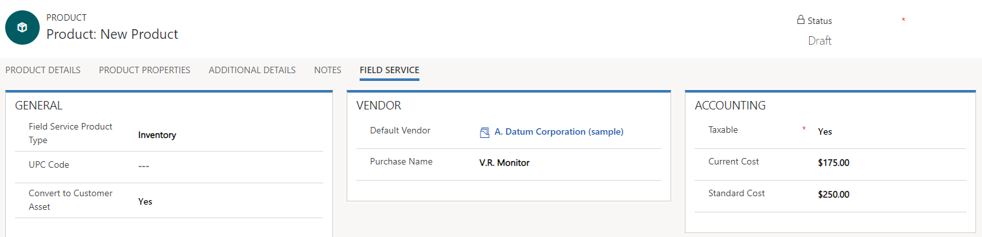
Field Service type should be set to inventory, non-inventory, or service.
Setting to yes, will automatically create a customer asset for the product when attached work order is closed.

Slide 3
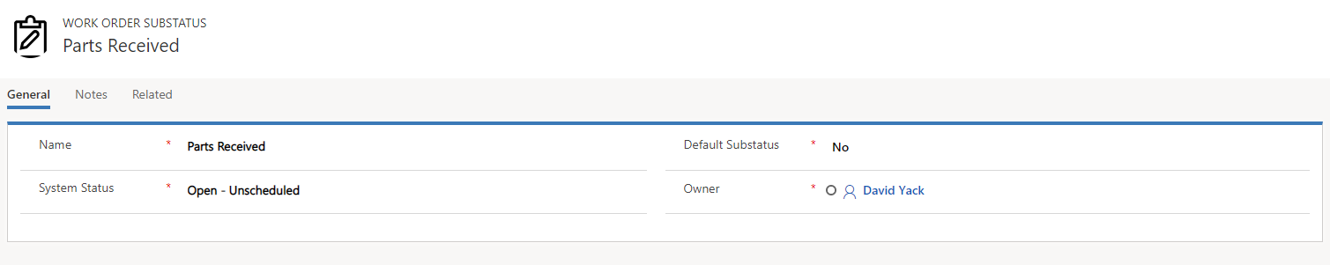
Setting to yes, will use as the default sub-status for the associated system status if not sub-status is defined for the record.
Ensures that the sub-status is attached to the correct status, and could be used to assist in scheduling.

Slide 4
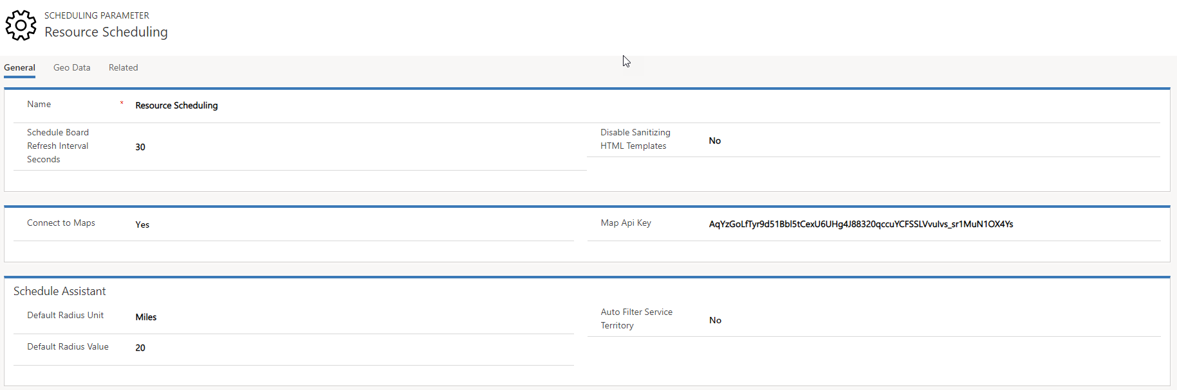
Not enabled by default. Should be set to yes.
Give consideration to service locations, and proximity to resources.

Slide 5
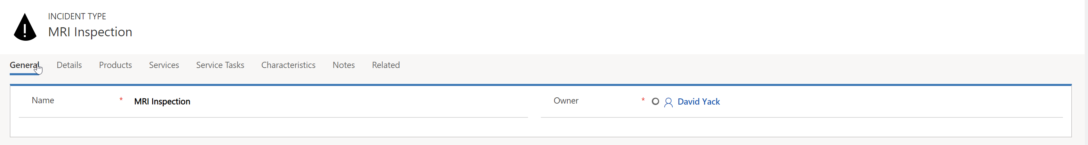
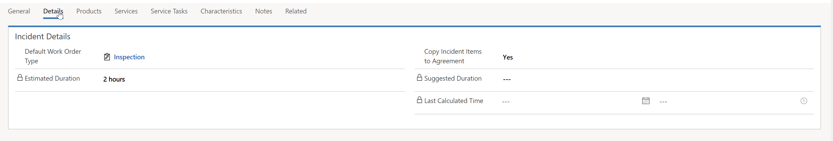
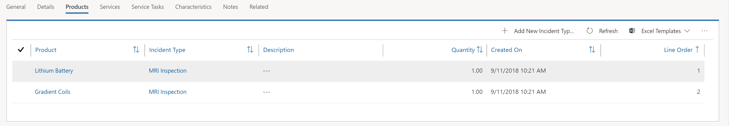
Duration based on total duration of all added service tasks.
Products defined will be auto-populated to the any work order associated with the Incident

Slide 6
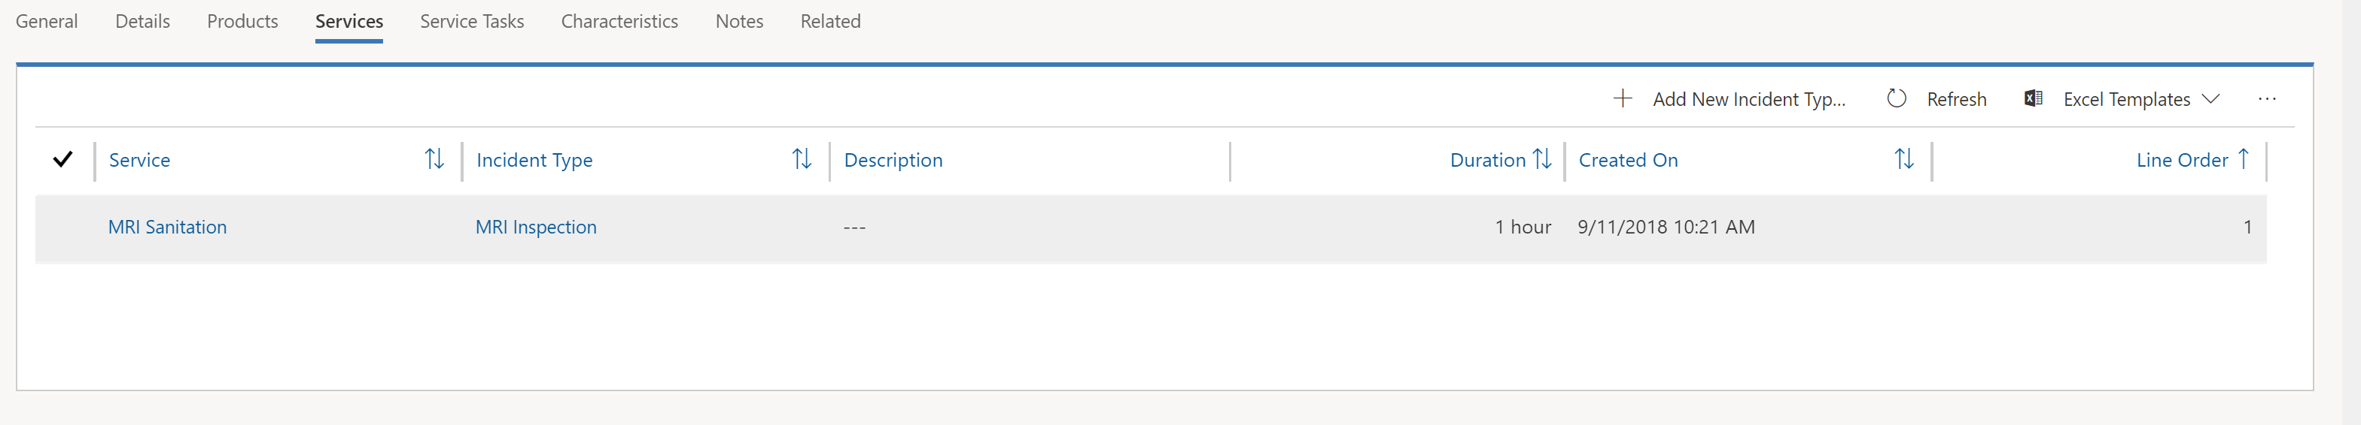
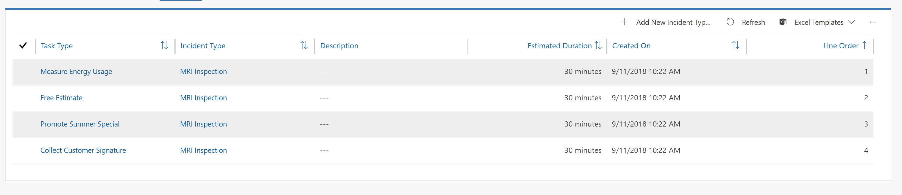
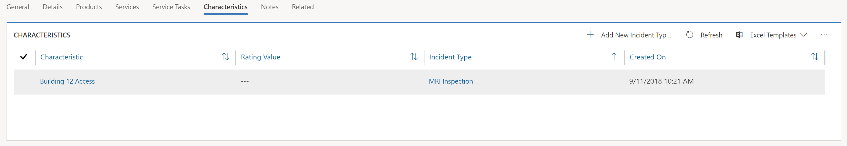
Products defined with a Field Service type of service can be added to the service section
Service tasks can be created individually and added to multiple incident types.

Slide 7
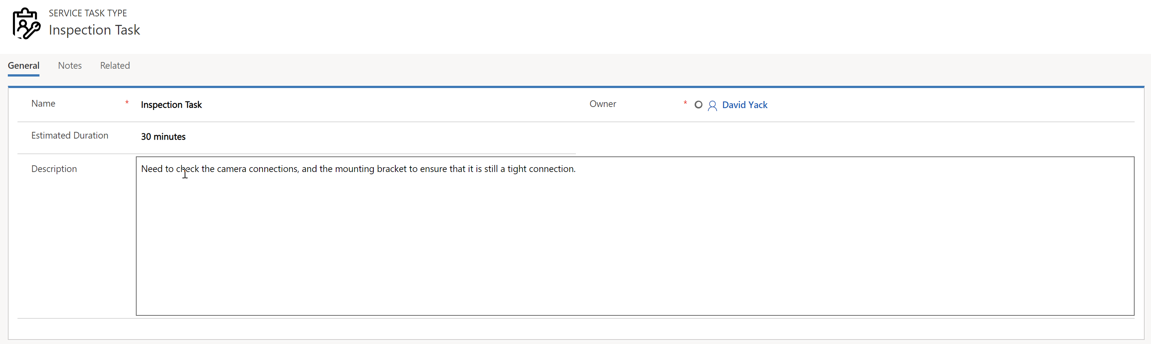

Slide 8
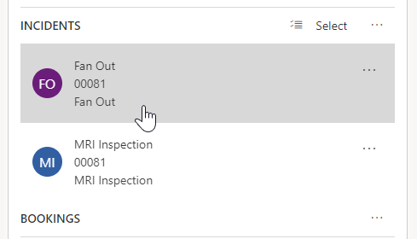
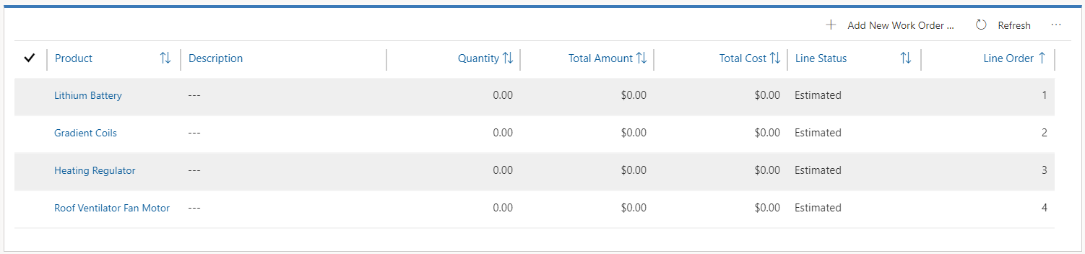
When multiple incidents are added to a work order, all products, services, tasks, and characteristics from all attached incidents are added.
Products added based on the MRI inspection incident being added.
Products added based on the fan out incident being added.

Slide 9
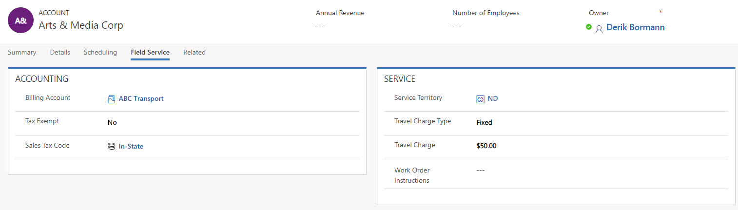
Information defined here will be automatically defined on new work orders created for the account.

Slide 10
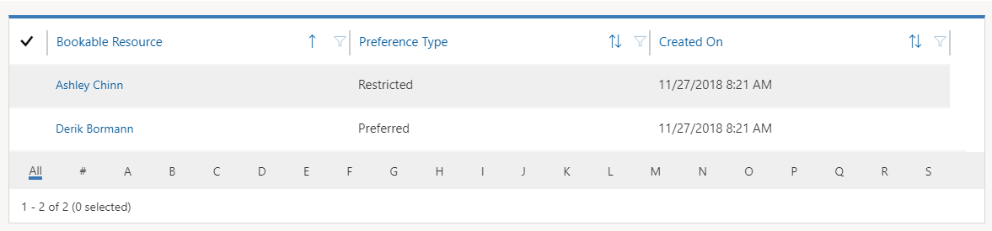
Restricted resources will have dates associated with them that define when the restriction on the resource will expire.

